Slide 1


Slide 2

Chapter 3.2
Queues
Aim
To educate the students with the basic queues, its types and operations on queues
knowledge of

Slide 3

Chapter 3.2
Queues
Instructional Objectives
Objectives of this chapter are:
Explain queue and its operations
Describe the array representation of Queue
Discuss different types of queue with example
Illustrate the creation, insertion, deletion and search operation on various types of queue

Slide 4
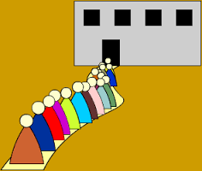
Introduction
Chapter 3.2 Queues

Slide 5
Chapter 3.2
Queues
Queue and its Operations

Slide 6
Queues
Queue and its Operations
Definition of Queue
Queue is an abstract data type or a linear data structure in which the first element is inserted from one end called REAR(also called tail), and the deletion of existing element takes place from the other end called as FRONT(also called head).

Slide 7
Queues
Queue and its Operations
Operations on queue
Insertion operation (enqueue)
Deletion operation (dequeue)
Qempty operation
Qfull operation
Display operation

Slide 8
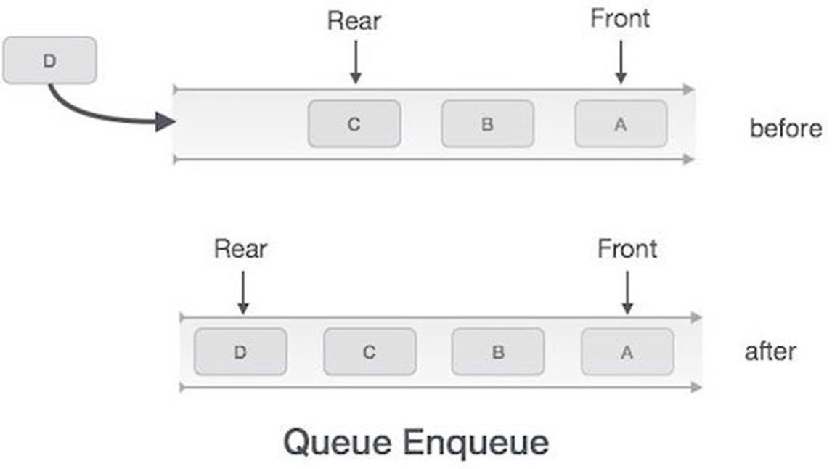
Queues
Queue and its Operations
Enqueue Operation

Slide 9
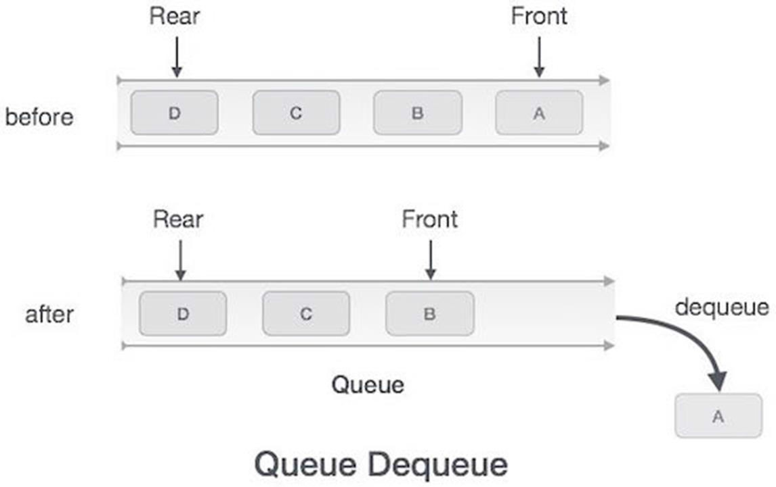
Queues
Queue and its Operations
Dequeue Operation

Slide 10
Queues
Queue and its Operations
Qempty Operation
Qempty() checks if the queue is empty. It returns Boolean value
Algorithm
begin procedure Qempty
if front is less than MIN OR front is greater than rear
return true else
return false endif
end procedure
10

Slide 11
Queues
Queue and its Operations
Qfull Operation
Qfull() function checks if the queue is full. It returns Boolean value.
Algorithm
begin procedure Qfull
if rear equals to MAXSIZE
return true else
return false endif
end procedure

Slide 12
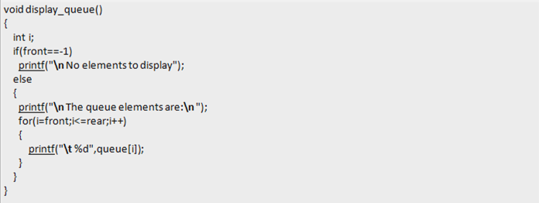
Queues
Queue and its Operations
Display Operation

Slide 13
Chapter 3.2
Queues
Array Representation of Queue

Slide 14
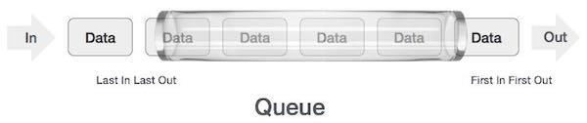
Queues
Array Representation of Queue
Array Representation of Queue

Slide 15
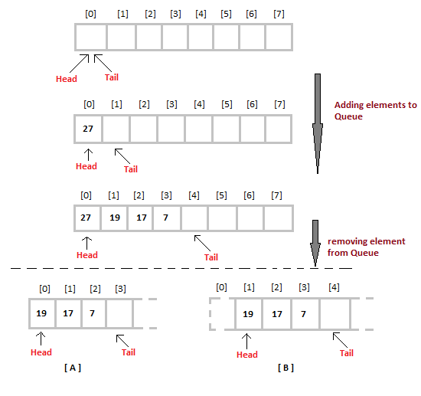
Queues
Array Representation of Queue
Implementation of Queue - Example

Slide 16

Queues
Array Representation of Queue
Quiz / Assessment
Which one of the following is an application of Queue Data Structure?
When a resource is shared among multiple devices
Printer jobs waiting to be processed.
Buffer used in network communication to store data packets
All of the above
For every enqueue operation, we by one, and for every dequeue operation, we
by one.
a) decrement rear , decrement front
c) increment front, increment rear
b) increment rear, increment front
d) decrement front, decrement rear
3) For queue implementation, we need two pointers namely front and rear. This pointers are
initialized as:
a) front=1 and rear=-1
c) front=-1 and rear=1
b) front=-1 and rear=-1
d) front=1 and rear=1

Slide 17
Chapter 3.2
Queues
Different Types of Queue with
Example

Slide 18
Queues
Different Types of Queue with Example
Types of Queues
Types of Queues
Double Ended Queue
Simple Queue
Circular Queue
Priority Queue

Slide 19
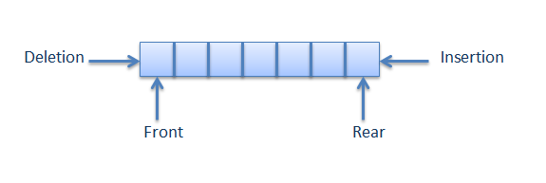
Queues
Different Types of Queue with Example
Simple Queue

Slide 20
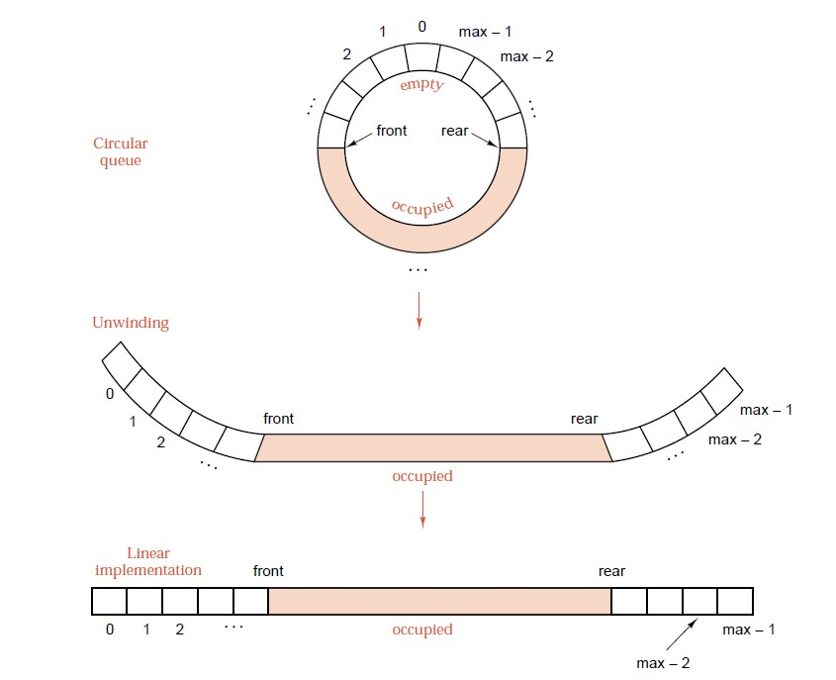
Queues
Different Types of Queue with Example
Circular Queue
20

Slide 21
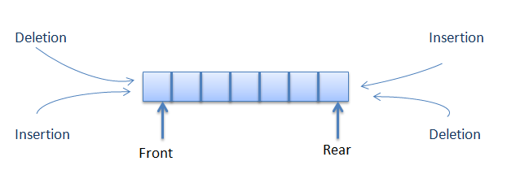
Queues
Different Types of Queue with Example
Double Ended Queue

Slide 22
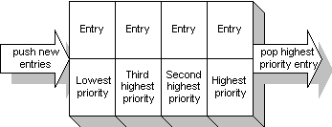
Queues
Different Types of Queue with Example
Priority Queue

Slide 23
Queues
Different Types of Queue with Example
Quiz / Assessment
4) A circular queue is implemented using an array of size 10. The array index starts with 0, front is 6, and rear is 9. The insertion of next element takes place at the array index.
0
7
9
10
5) If the MAX_SIZE is the size of the array used in the implementation of circular queue, array index start with 0, front point to the first element in the queue, and rear point to the last element in the queue. Which of the following condition specify that circular queue is EMPTY?
Front=rear=0
Front= rear=-1
Front=rear+1
Front= (rear+1)%MAX_SIZE
6) A normal queue, if implemented using an array of size MAX_SIZE, gets full when
Rear=MAX_SIZE-1
Front= (rear+1)mod MAX_SIZE
c)Front=rear+1
d)Rear=front

Slide 24
Chapter 3.2
Queues
Creation, Insertion, Deletion and Search
Operation on Various Types of Queue

Slide 25
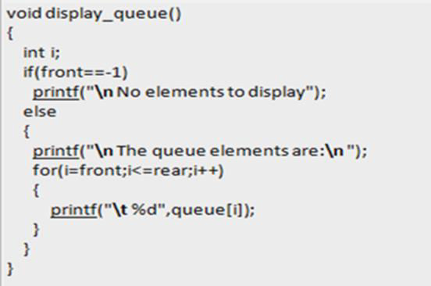
Queues
Creation, Insertion, Deletion and Search Operation on Various Types of Queue
Creation of queue
Queue can be created by simply moving rear pointer till it reaches the front pointer

Slide 26
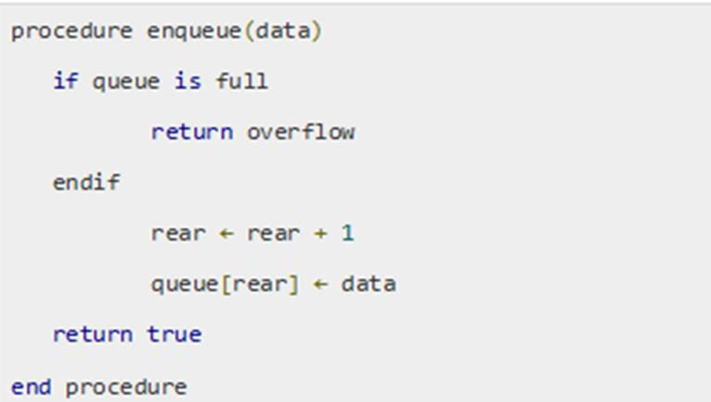
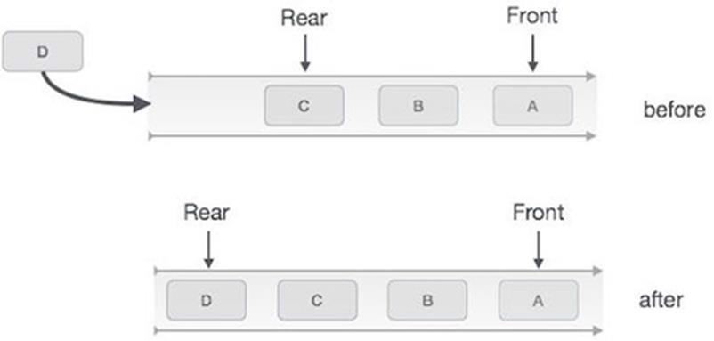
Queues
Creation, Insertion, Deletion and Search Operation on Various Types of Queue
Insertion in queue
Insertion in queue is also called as enqueuer operation.

Slide 27
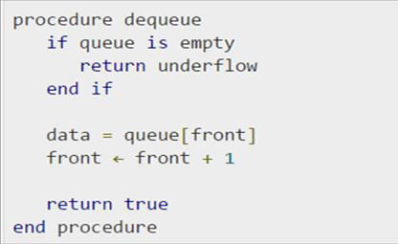
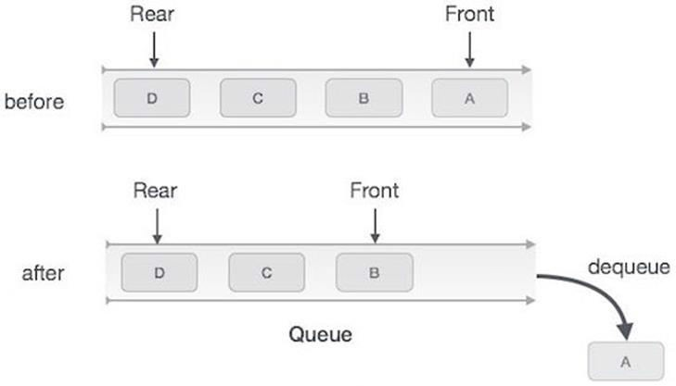
Queues
Creation, Insertion, Deletion and Search Operation on Various Types of Queue
Deletion of queue
Deletion operation from the queue is also called as dequeue operation

Slide 28
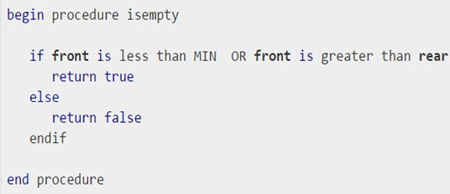
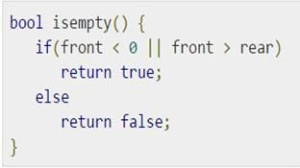
Queues
Creation, Insertion, Deletion and Search Operation on Various Types of Queue
Qempty operation
Algorithm of Qempty() function −
In C Programming

Slide 29
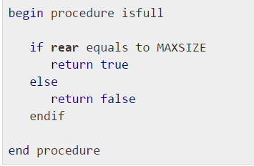
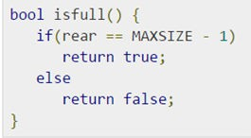
Queues
Creation, Insertion, Deletion and Search Operation on Various Types of Queue
Qfull operation
Algorithm of Qfull() function −
In C Programming

Slide 30
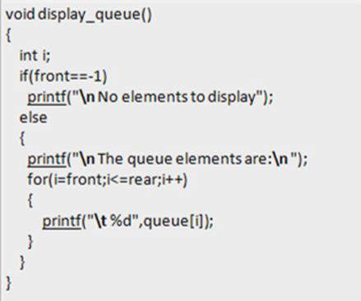
Queues
Creation, Insertion, Deletion and Search Operation on Various Types of Queue
Display operation
30

Slide 31
Queues
Creation, Insertion, Deletion and Search Operation on Various Types of Queue
Quiz / Assessment
7) If the elements "A", "B", "C" and "D" are placed in a queue and are deleted one at a time,
in what order will they be removed?
ABCD
DCBA
Deletion operation is done using ......... in a queue.
Front
Rear
DCAB
BADC
c)Top d)Bottom
9) An array of size MAX_SIZE is used to implement a circular queue. Front, Rear, and count are tracked. Suppose front is 0 and rear is MAX_SIZE -1. How many elements are present in the queue?
Zero
One
c)MAX_SIZE-1
d)MAX_SIZE

Slide 32
Queues
Queue and its Operations
Application of Queue
Scheduling for the computer resource sharing based applications
CPU scheduling
Application of queue is routing calls in call centres
Interrupt Handling
5. M/M/1 queue

Slide 33
Queues
Creation, Insertion, Deletion and Search Operation on Various Types of Queue
Quiz / Assessment
10) Which data structure allows deleting data elements from front and inserting at rear?
Stacks
Queues
Dequeues
Binary search tree
The push and enqueue operations are essentially the same operations, push is used for Stacks and enqueue is used for Queues.
True b) False
In order to input a list of values and output them in order, you could use a Queue. In order to input a list of values and output them in opposite order, you could use a Stack.
True b) False

Slide 34



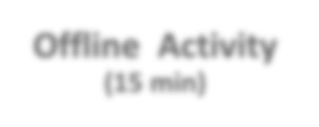
Chapter 3.2
Queues
Activity
Brief description of activity
Fill in the following table to give the running times of the priority queue operations for the given two implementations using O () notation. You should assume that the implementation is reasonably well done, for example, not performing expensive computations when a value can be stored in an instance variable and be used as needed.
Offline Activity
(15 min)
A priority queue is a data structure that supports storing a set of values, each of which has an associated key. Each key-value pair is an entry in the priority queue. The basic operations on a priority queue are:
insert(k, v) - insert value v with key k into the priority queue

Slide 35


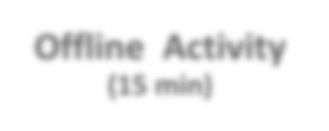

Chapter 3.2
Queues
Activity
Brief description of activity
removeMin()-return and remove from the priority queue the entry with the smallest key
Other operations on the priority queue include size (), which returns the number of entries in the queue and is Empty () which returns true if the queue is empty and false otherwise.
Two simple implementations of a priority queue are an unsorted list, where new entries are added at the end of the list, and a sorted list, where entries in the list are sorted by their key values.
Offline Activity
(15 min)

Slide 36

Chapter 3.2
Queues
Summary
Similar to stacks, Queues are data structure usually used to simplify certain programming operations.
In these data structures, only one data item can be immediately accessed.
A queue, in general, allows access to the first item that was inserted.
The important queue operations are inserting an item at the rear of the queue and removing the item from the front of the queue.
A queue can be implemented as a circular queue, which is based on an array in which the indices wrap around from the end of the array to the beginning.
A priority queue allows access to the smallest (or sometimes the largest) item in the queue.
The important priority queue operations are inserting an item in sorted order and removing the item with the smallest key.
Few important operations performed on the queue are insertion which is also called enqueue, deletion also called dequeues, Qempty which check if queue is empty, Qfull which check if queue is full and display which is used to display all the elements in the queue.
Queues finds its applications in implementing job scheduling algorithms, page replacement algorithms, interrupt handling mechanisms etc. in the design of operating systems.

Slide 37

Chapter 3.2
Queues
e-References
bowdoin.edu, (2016). Computer Science 210: Data Structures . Retrieved on 19 April 2016, from
http://www.bowdoin.edu/~ltoma/teaching/cs210/fall10/Slides/StacksAndQueues.pdf
Tutorialspoint.com, (2016). Queues. Retrieved on 19 April 2016, from
https://www.tutorialspoint.com/data_structures_algorithms/dsa_queue.htm
Cs.cmu.edu, (2016). Stacks and Queues. Retrieved on 19 April 2016, from https://www.cs.cmu.edu/~adamchik/15- 121/lectures/Stacks%20and%20Queues/Stacks%20and%20Queues.html

Slide 38

Chapter 3.2
Queues
External Resources
1. Data Structures and program designing using 'C' ,Robert Kruse, 2nd
Edition,
Pearson Education
2. Data Structures and Algorithm Analysis in C ,Weiss, 2nd
Edition, Pearson
Education, 2001
3. Data structures in C ,D. Srivastava, 1st Edition,BPB publishers, 2004

Slide 39
Chapter 3.2
Queues
Thank you

